Slide 1
Session 3: Single-cell RNA-seq Normalization, Batch Correction and Differential Expression
Reuben Thomas
Gladstone Bioinformatics Core
November 11/12, 2020

Slide 2
Outline for this session
Main messages
Introduce the data and the research questions
Primer on statistics
Outline for the hands-on session
Reiterate the main messages

Slide 3
Main points I want to convey
State of art of the design and statistical analyses of scRNAseq data is far from optimal
There are better designs
Most important: Please include replicates drawn from the population you want to make a claim about
There are better statistics/ways to get “more” reproducible results.
Normalization
Differential expression
(WARNINGS)
Notes:
Every scRNA-seq data may look similar to tools like Seurat/scNetViz.
But underlying the data is a story, a design
Whatever tests we perform to estimate p-values, should take into account this design.
Unless the variability and dependency implicit in the design is taken into account in estimating fold-changes, the associated p-values are incorrect. We are therefore not controlling the number false positives in any resulting list of genes. Our designs and associated analyses may then end up black lists created by John Ionidis.

Slide 4
Outline for this session
Main messages
Introduce the data and the research questions
Primer on statistics
Outline for the hands-on session
Reiterate the main messages

Slide 5
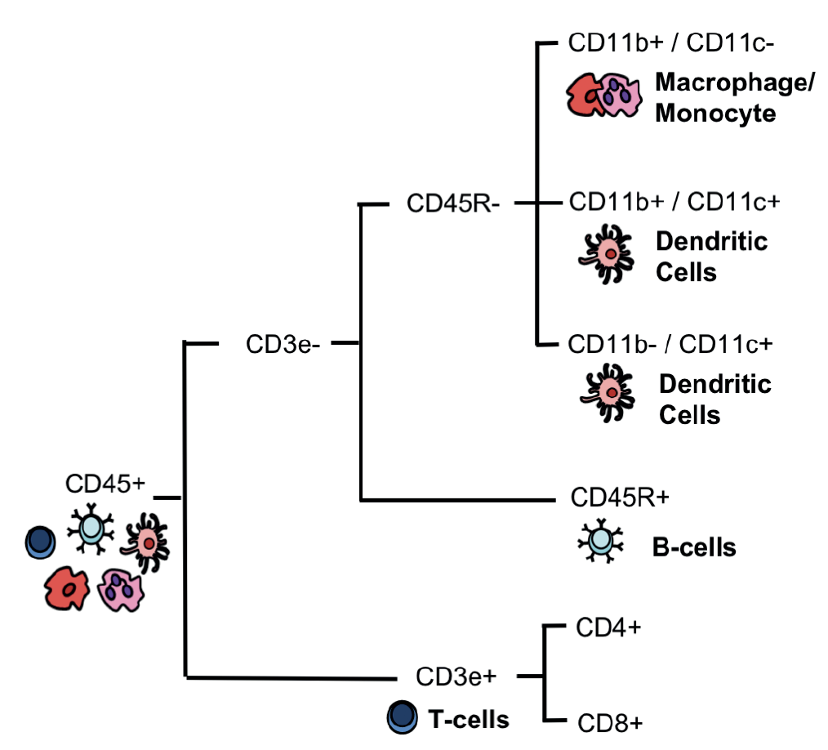
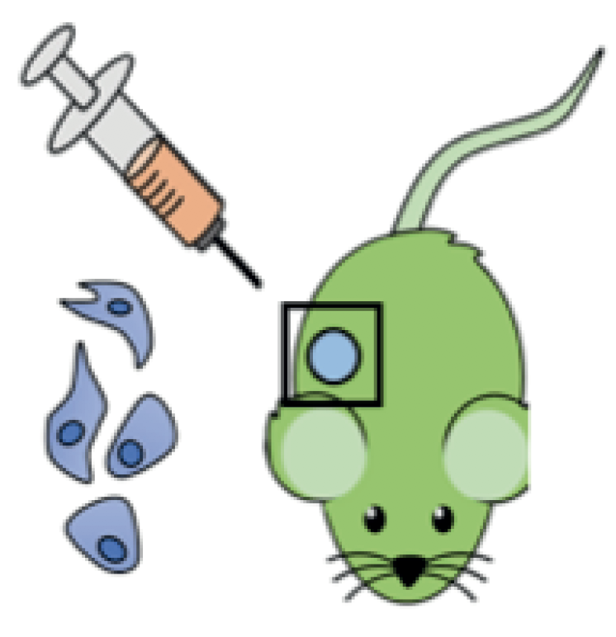
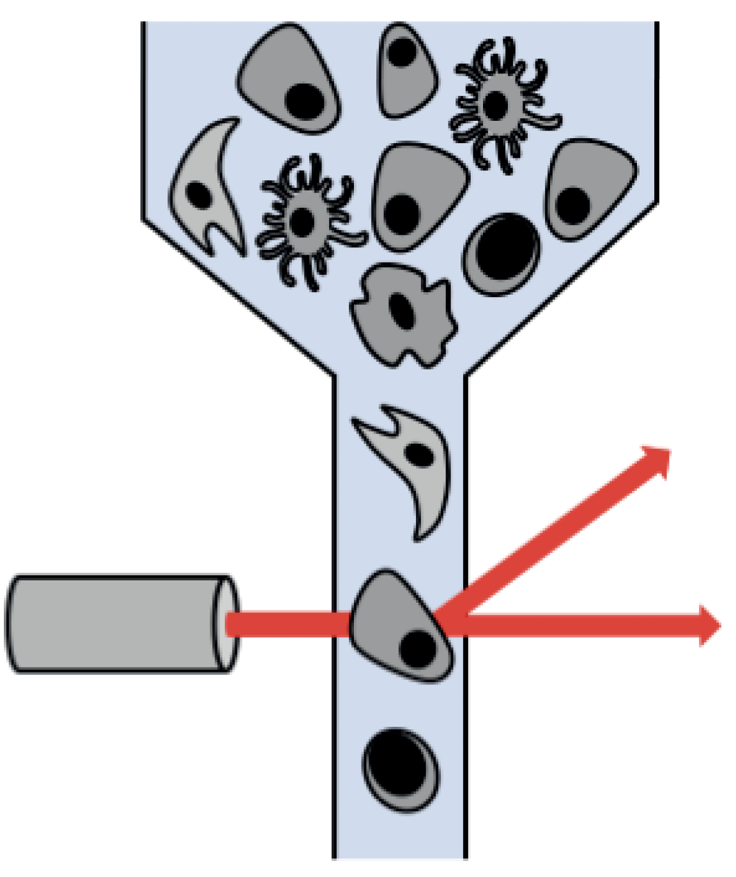
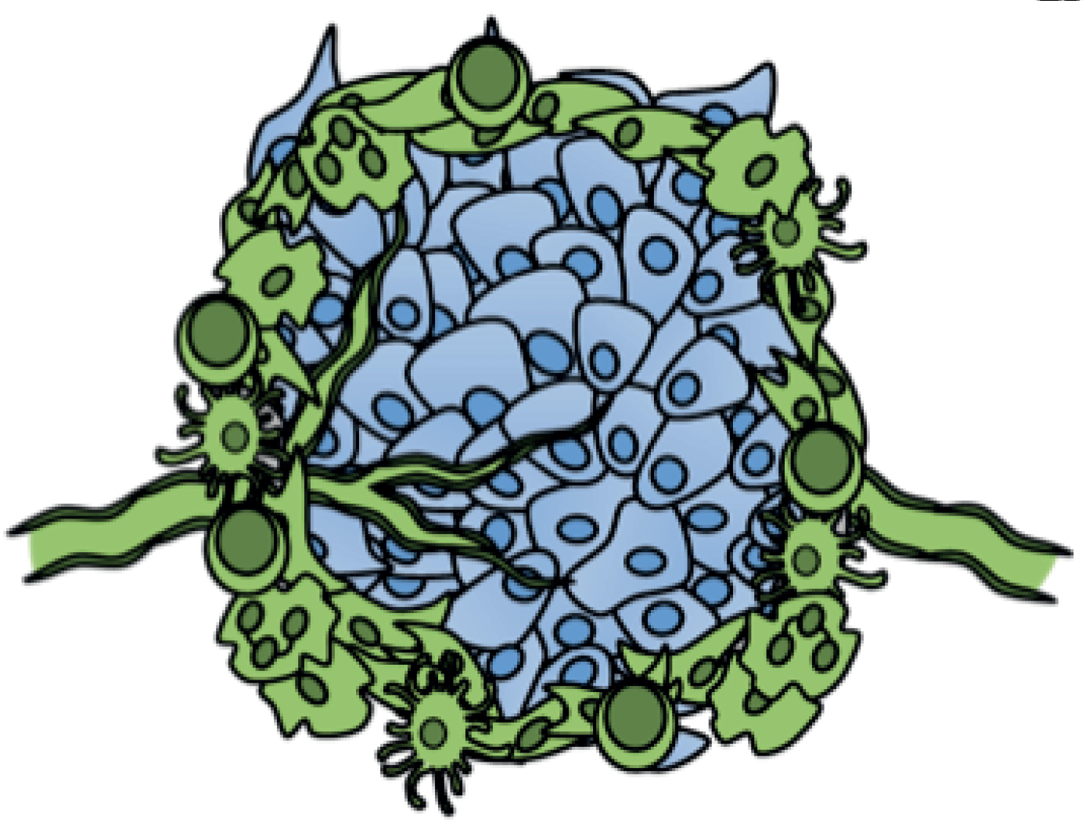
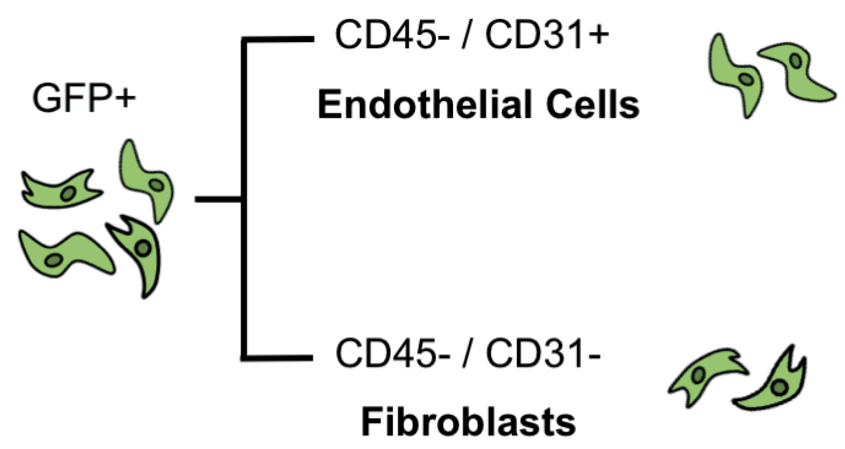
Dissecting the Tumor Microenvironment
GFP+ Mice were injected with a melanoma cell line
Host and tumor cells were then sorted and sequenced
Grow tumor (5, 11 days)
FACS sort cells
Source: David Joy
Davidson et al. bioRxiv 2018

Slide 6
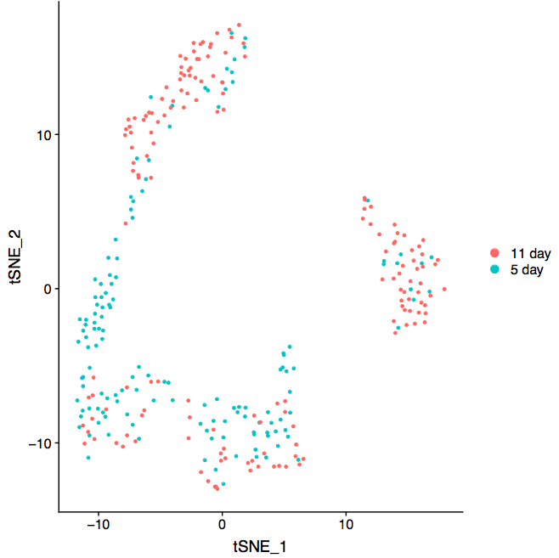
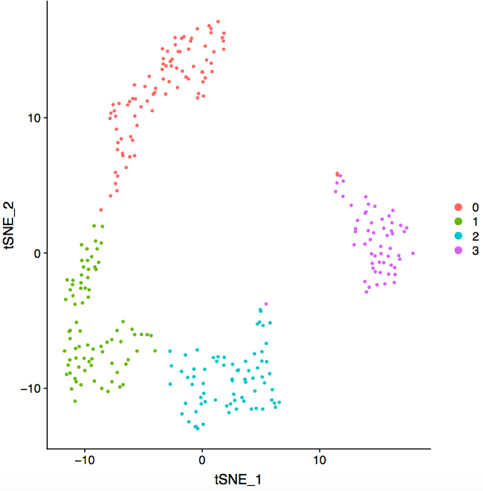
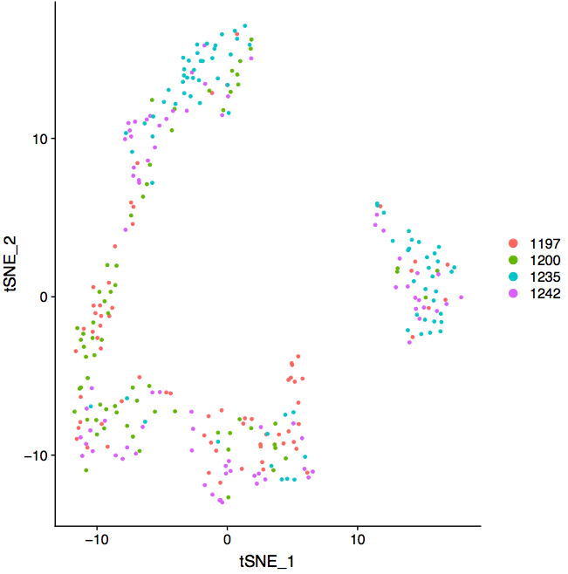
Fibroblast cells over Time, Clusters and Individuals
Time
Cluster
Individual

Slide 7
Research Questions
Genes associated with time: which genes change their expression in the host fibroblast cells from the 5 day time-point to the 11 day time-point?
Would like to take into account inter-individual variability – make generalizable claims
Would make claims specific to particular clusters or implied cell-types to this population of cells – after all we have scRNA-seq data, ☺.
Would like to avoid the multiple testing problem and make statistically rigorous claims

Slide 8
Outline for this session
Main messages
Introduce the data and the research question
Primer on statistics
Outline for the hands-on session
Reiterate the main messages

Slide 9
Predictors of gene expression in a given cell
Time
Individual
Gene 1
Cell-type
Exp. factors

Slide 10
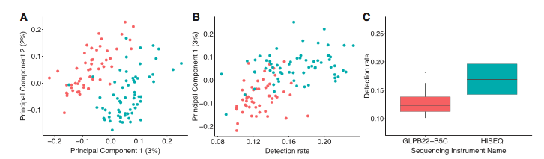
Gene detection rate is a good surrogate for batch effect
Experimental factors ~ gene detection rate
Hicks, S. C., Townes, F. W., Teng, M. & Irizarry, R. A. Missing data and technical variability in single-cell
RNA-sequencing experiments. Preprint available from:https://doi.org/10.1093/biostatistics/kxx053 (2017).

Slide 11
We could use cluster as surrogate for cell-type
Cell-type ~ cluster
WARNING 1:
Data dredging: use the same data to define
clusters of cells and differences in gene expression
between these clusters

Slide 12
Predictors of gene expression
Time
Individual
Gene 1
Cell-type
Cluster
Exp. Factors
Detection

Slide 13
Predictors of gene expression
Gene1
Gene 7000
Time
Time
Individual
……..
Individual
Gene 1
Gene 7000
Cluster
Cluster
Detection
Detection

Slide 14
Distribution of p-values across all genes and reproducibility(simulated data)
Log odds ratio of the same gene
having a logFC > 1 in two
independent experiments = 8

Slide 15
Outline for this session
Main messages
Introduce the data and the research question
Primer on statistics
Outline for the hands-on session
Reiterate the main messages

Slide 16
Define batch effects
“Batch effects are sub-groups of measurements that have qualitatively different behaviour across conditions and are unrelated to the biological or scientific variables in a study”: Leek et al 2010
I am yet to encounter an RNA-seq data that does not display appreciable batch effects in my 10 years experience working with RNA-seq!!

Slide 17
Batch effects could arise
In your experiments where subset of samples are processed are differently – different times, people, library prep
When you want to compare your data to publicly accessible data

Slide 18
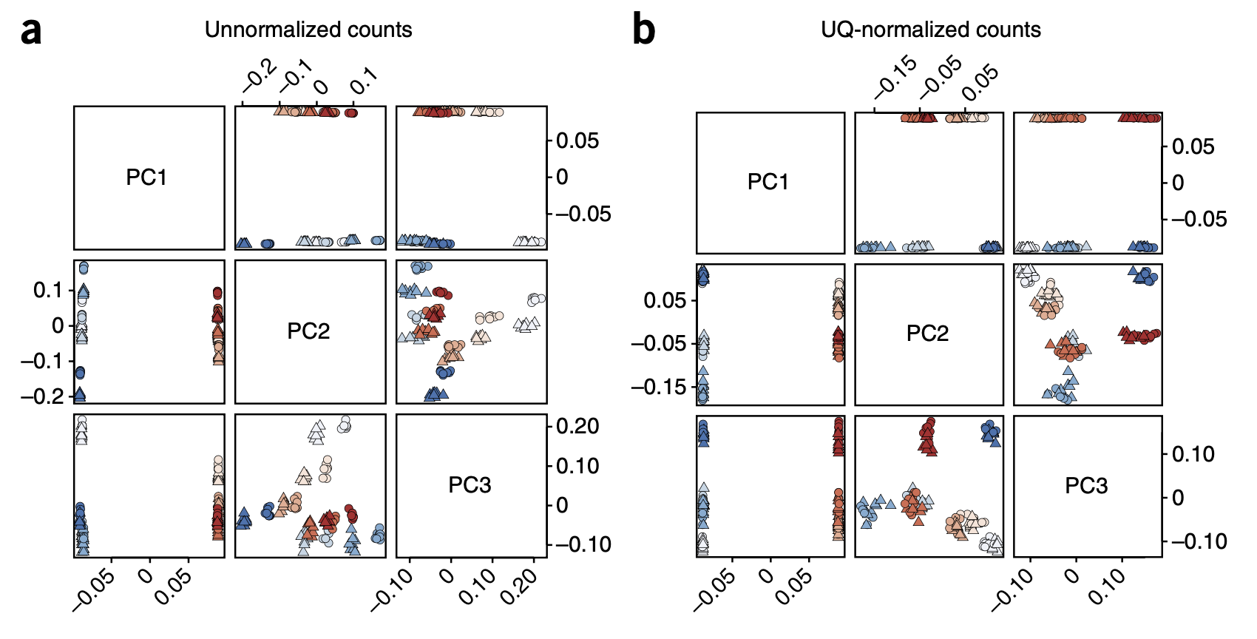
Red/Blue: different biological conditions
Shade of color: library prep date
Circles and Triangles: two different flow cells
Notes:
Risso et al 2014

Slide 20
Why all this fuss about normalization and batch correction?
Significance of conclusions will be questioned if one does perform these steps
RNA-seq counts are representative of RELATIVE and NOT ABSOLUTE levels of gene expression
Covid-19 sample1 in USA has body temperature 102 while
Covid-19 sample2 in UK has body temperature 39.
Gata4 gene has 103 read counts in replicate 1 at E9.5,
has 576 read counts in replicate 3 at E11.5

Slide 21
Why do these methods work?
With RNA-seq you are not assaying 1 genes but 1000s
The methods all rely on the assumption that whatever process you are studying affects only a small subset of genes, i.e., the expression of most genes should be unaffected across all the samples

Slide 22
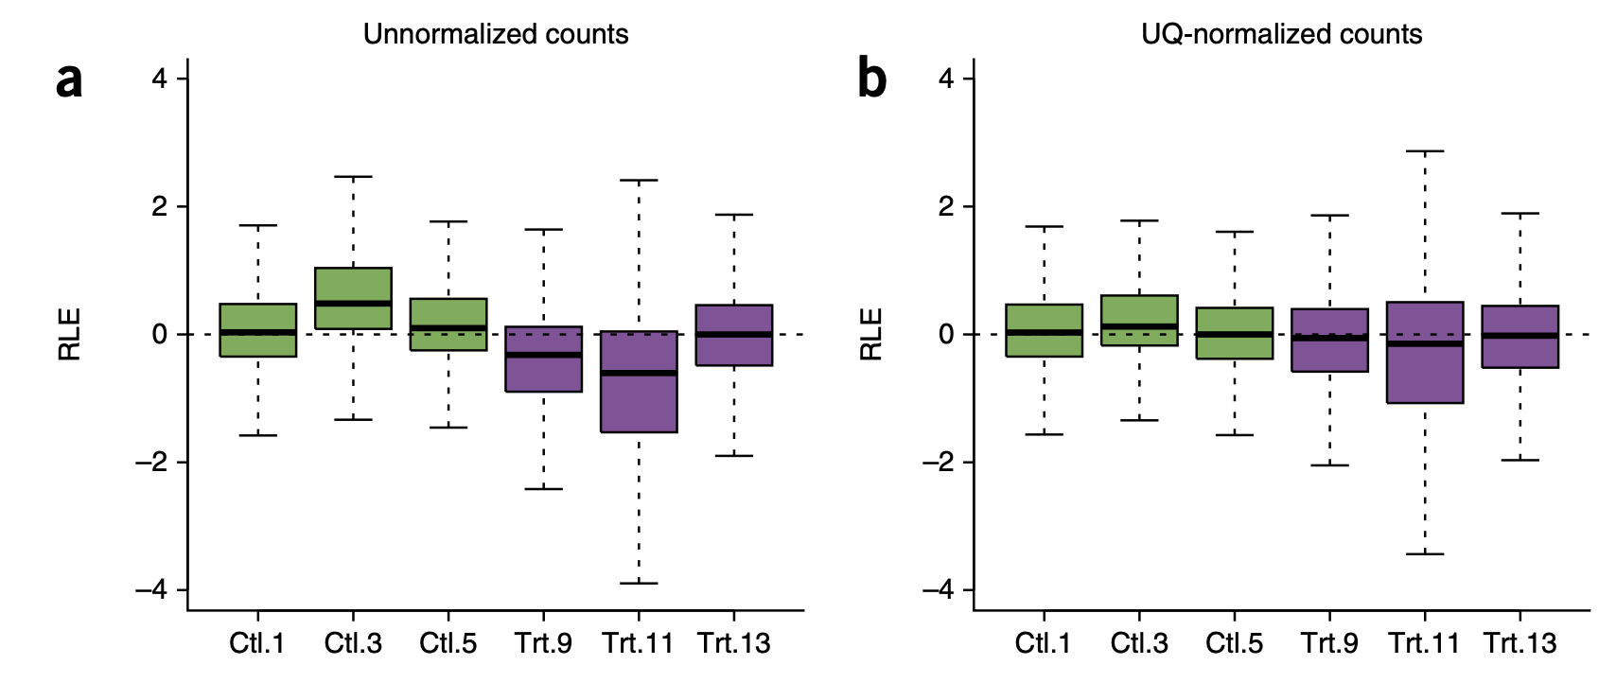
Normalization vs Batch effects
Normalization methods are sample-specific: a uniform factor is applied across all genes within a sample
Batch effects affects will not have an uniform effect across all genes
Notes:
Risso et al 2014

Slide 23
Gene expression
BiologicalCondition1
BiologicalCondition2
TechnicalCondition

Slide 24
For biological conclusions to be taken seriously…
BiologicalCondition
TechnicalCondition

Slide 25
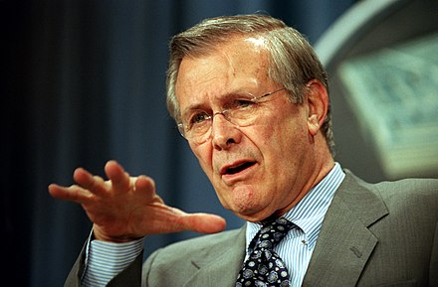
Technical Conditions & Donald Rumsfeld
Known knowns: Sample prep date
Your experiments
Known unknowns and Unknown unknowns: ??
Public data
We can know the answers to this by the magic
of PCA (correctly applied)!!!
Notes:
https://en.wikipedia.org/wiki/There_are_known_knowns

Slide 26
Which is a better design?
 | Design 1 – Sample prep date | Design 2 – Sample prep date
Sample_1_E9.5 | Jan 9th, 2019 | Jan 11th, 2019
Sample_2_E9.5 | Jan 9th, 2019 | Jan 9th, 2019
Sample_3_E9.5 | Jan 9th, 2019 | Jan 11th, 2019
Sample_4_E9.5 | Jan 9th, 2019 | Jan 9th, 2019
Sample_1_E11.5 | Jan 11th, 2019 | Jan 11th, 2019
Sample_2_E11.5 | Jan 11th, 2019 | Jan 9th, 2019
Sample_3_E11.5 | Jan 11th, 2019 | Jan 11th, 2019
Sample_4_E11.5 | Jan 11th, 2019 | Jan 9th, 2019

Slide 27
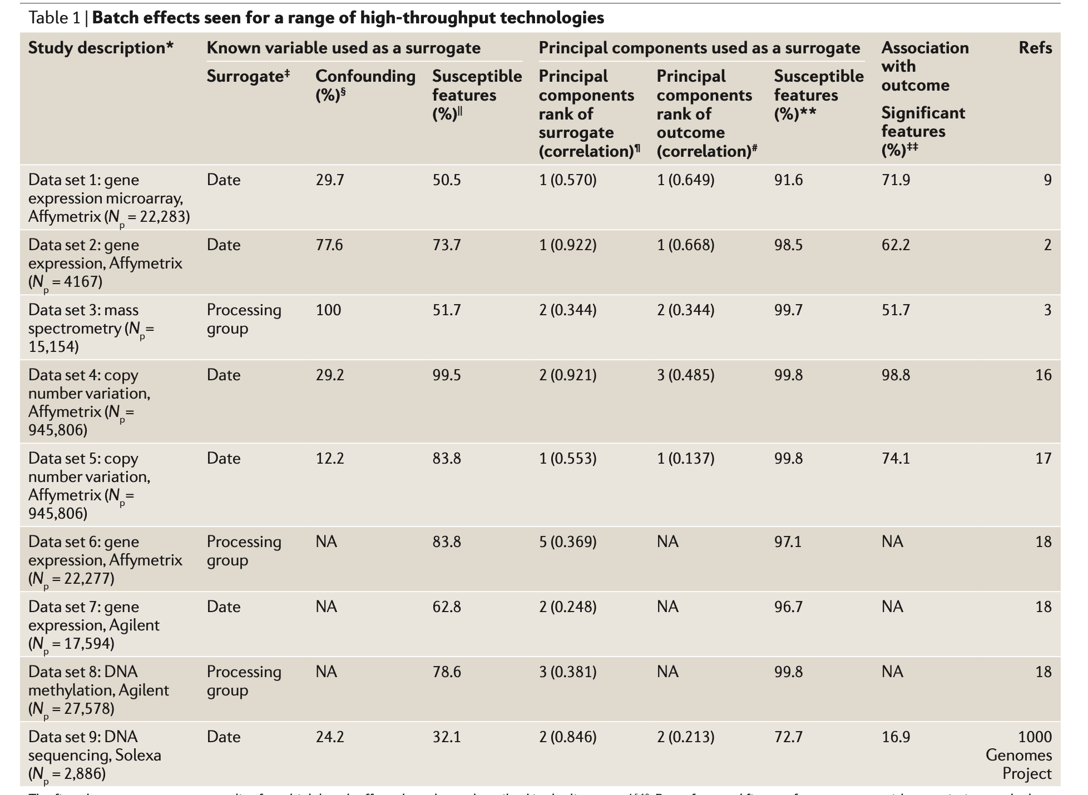
Notes:
Leek et al 2010

Slide 28
Known knowns: Visualization
Include ONLY technical conditions as variables in the linear model specified in edgeR, DESeq2 or voom
Use Combat-seq
Linear models allows for differences in mean expression and assumes variance is same of expression is the same between batches
Combat-seq allows for differences in means and variances.
Visualize the residuals of models using PCA

Slide 29
Known unknowns and Unknown unknowns: Visualization
Identify latent or surrogate variables using tools like sva-seq, RUV-seq
Get (latent variable) adjusted counts and perform visualization using PCA

Slide 30
Known knowns: differential expression
Include biological conditions AND technical conditions as variables in the linear model specified in edgeR, DESeq2 or voom
Use Combat-seq

Slide 31
Known unknowns and Unknown unknowns: differential expression
Include latent or surrogate variables along with biological conditions identified using tools like sva-seq, RUV-seq in the linear models and proceed

Slide 32
Known unknowns and Unknown unknowns: How do these methods work?
Idea 1: We have a good negative control set of genes. Genes we do not expect to be altered between the two batches.
E.g. Housekeeping genes, ERCC spike-ins, empirical identification
Idea 2: Any systematic variation (as captured by the top PCs) left over after the biological effects have been accounted represent unwanted effects

Slide 33
Decisions to be made
The number of latent variables to include
Arbitrary, subjective, usually by trial and error
Very Very Very important: Need a common anchor condition present between batches being compared
Particularly relevant when using public dataset
Only way you can convince yourself and others that batch correction was effective

Slide 34
BEFORE BATCH CORR.
AFTER BATCH CORR.

Slide 35
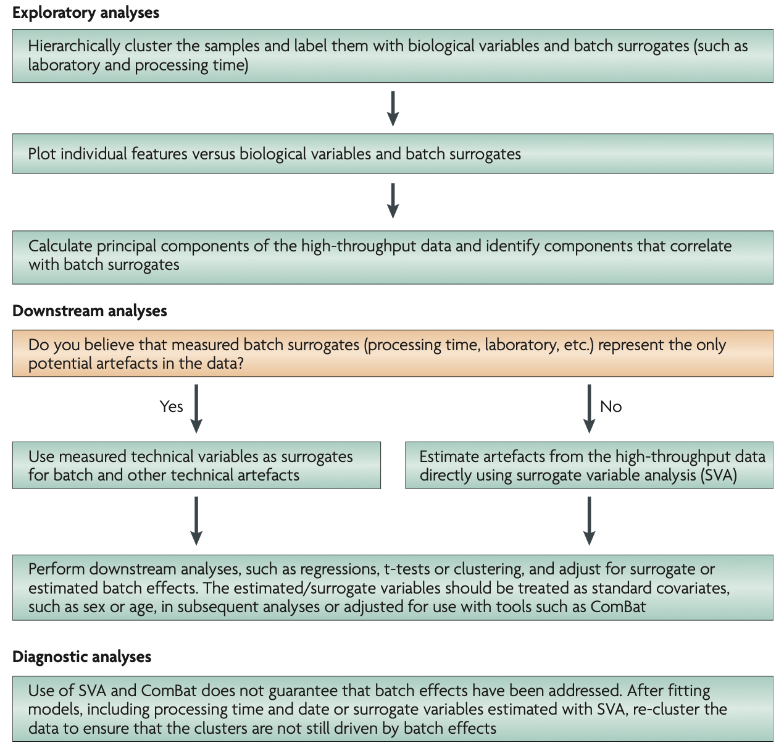
Decision flowchart: old but useful

Slide 36
Cheatsheet
Setting | Example | Tool
Known known | Clearly defined technical variables like sample prep date, technique: Your experimental studies | edgeR, DESeq2, voom, Combat-seq
Unknown known and Unknown unknowns | Unable to clearly define technical variables: Publicly accessible data | sva-seq, RUV-seq

Slide 37
Outline for hands-on session
Load the raw data in Seurat for filtering cells and basic visualization
Normalize data using zinbwave, estimate corresponding low-dimensional normalized data for visualization and compute weights for gene expression association analyses
Estimate gene expression association with time controlling for other factors using edgeR.
Cluster the expression of genes across cells and visualize the associated data.

Slide 38
ZINB-WAVE: Zero-Inflated Negative Binomial Model for RNA-Seq Data
Normalization method specifically designed to exploit the unique characteristics of scRNA-seq data
Allows one to include cell-type variables (gene detection rate) in the normalization procedure – potentially controlling for technical sources of variables.
Output estimates than can be used to appropriately used to model the multiple factors in the data using edgeR - a tool designed for bulk-rna-seq data.
Risso D, Perraudeau F, Gribkova S, Dudoit S, Vert J (2018). “A general and flexible method for signal extraction from single-cell RNA-seq data.” Nature Communications, 9, 284.

Slide 39
Linear models in edgeR
nFeature_RNA ~ gene detection rate
Y~nFeature_RNA + Clusters + Time + Clusters:Time
Genes associated with time are identified by significance of Time and Clusters:Time.
WARNING 2:
We have failed to take into account dependency of cells on their
animal of origin resulting in elevated significance p-values
Notes:
Takes into account potential technical sources of variation using detection rate, potential variation associated with clusters/cell-types and individuals.
Only one test, one p-value per gene, so multiple testing across all genes once.
How do identify cluster specific effects?

Slide 40
Clustering and visualization to further parse apart gene expression associations

Slide 41
Outline for this session
Main messages
Introduce the data and the research questions
Primer on statistics
Outline for the hands-on session
Reiterate the main messages

Slide 42
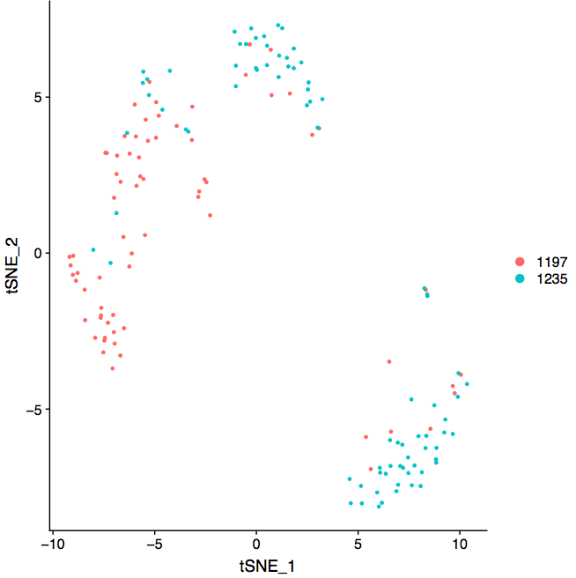
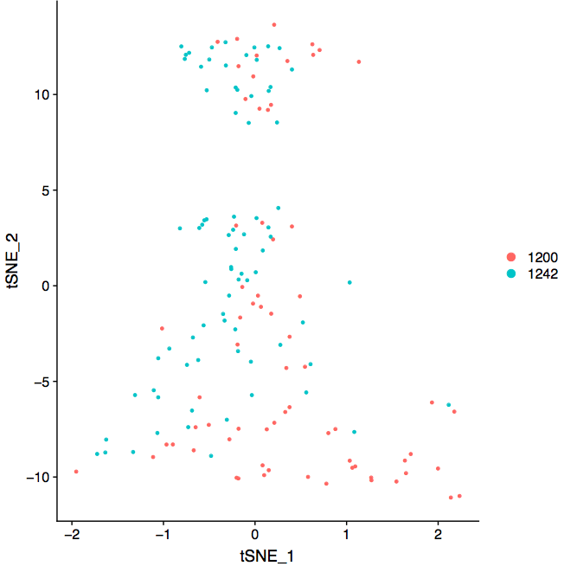
Training and Test Sets
Training Set
Test Set
Individual
Individual

Slide 43
p-values supposed to reflect repeat experiments but…
For the training set,
Poor correlation between two sets of replicates

Slide 44
Main points I wanted to convey
State of art of the design and statistical analyses of scRNAseq data is far from optimal
There are better designs
Most important: Please include replicates drawn from the population you want to make a claim about
There are better statistics/ways to get “more” reproducible results.
Normalization
Differential expression
(WARNINGS)
Notes:
Every scRNA-seq data may look similar to tools like Seurat/scNetViz.
But underlying the data is a story, a design
Whatever tests we perform to estimate p-values, should take into account this design.
Unless the variability and dependency implicit in the design is taken into account in estimating fold-changes, the associated p-values are incorrect. We are therefore not controlling the number false positives in any resulting list of genes. Our designs and associated analyses may then end up black lists created by John Ionidis.

Slide 45
Thank you
David Joy, McDevitt Lab
Krishna Chaudhary, Bioinformatics Core
Alex Pico, Bioinformatics Core
Eva Wang, Bioinformatics Core

Slide 46
Distribution of p-values across all genes (simulated data)

Slide 47
Scatter of fold-changes over repeated experiments (simulated data)
More left skewed p-value distribution, the more reproducible the results!

Slide 48
Correctly identifying time-associated genes within Seurat is difficult
Inference at the cluster level is not advisable
Inference with time is possible but will ignore the underlying heterogeneity of the cells
Inference within time by cluster is possible but multiple testing issue.
Notes:
Inference at cluster level is not advisable
How does one reproduce these results?
What experimental design will allow you to sample cells from cluster 7 and cluster 9?
This data was generated with a specific design, a hierarchical one – within a given time-point, two replicates are chosen, within each replicate cells are chosen
So any p-values one gets from identifying time associated genes will be incorrect. We are not making sure our results are reproducible.
I am going to describe an approach that will provide more honest p-values. The approach will use tools that are existing but is not going to be as straightforward as clicking a button. Every data set is unqiue. You will need to put some thought into it or discuss with a biostatistician.

Slide 49
Upcoming sessions
Session 4: Network analysis of single-cell data, trajectory analysis, Q&A. (Fri)

Slide 50
Helpful resources
Wynton Slack channel
ucsf-wynton.slack.com
Gladstone Bioinformatics Core slack channel
https://gladstoneinstitutes.slack.com/archives/C0145F1L7QS
Wynton tutorials
https://github.com/ucsf-wynton/tutorials/wiki

Slide 51
Your feedback is important to us!
https://www.surveymonkey.com/r/RRTZPTC
~3 min.

